Slide 1
STAT 504 – Network and Text Analytics Lecture 3: Import and Export Network Data
By Dr. Ellie Small

Slide 2
Overview
Topics:
Review
Bipartite Networks
Problems
Import and Export Network Data: Adjacency Matrices and Edge Lists
Import and Export Network Data: Data Frames
Import and Export Network Data: Other Methods
Components
Problem

Slide 3
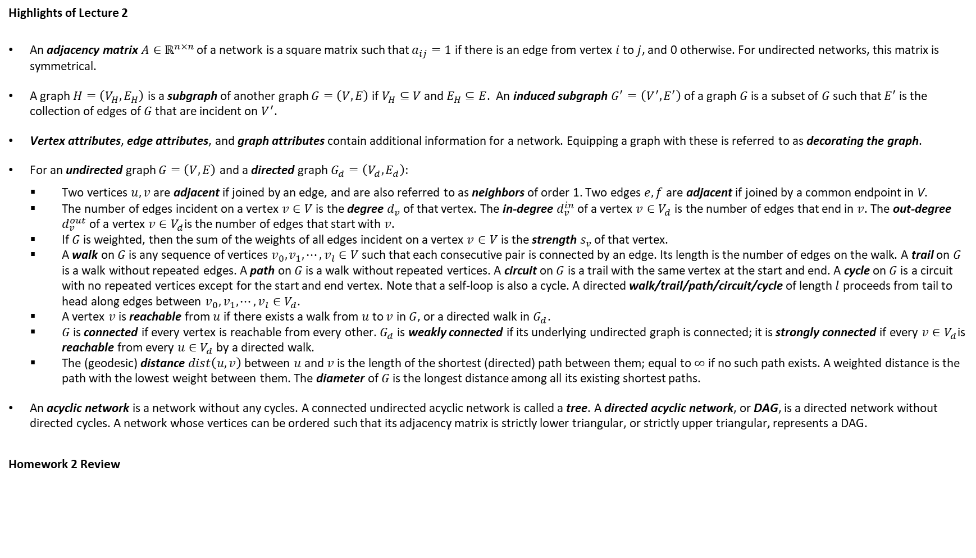
Review
Highlights of Lecture 2
An adjacency matrix $A∈ℝ^{n×n}$ of a network is a square matrix such that $a_{ij}=1$ if there is an edge from vertex $i$ to $j$, and 0 otherwise. For undirected networks, this matrix is symmetrical.
A graph $H=\left(V_{H},E_{H}\right)$ is a subgraph of another graph $G=\left(V,E\right)$if $V_{H}⊆V$ and $E_{H}⊆E$. An induced subgraph $G^{′}=\left(V^{′},E^{′}\right)$ of a graph $G$ is a subset of $G$ such that $E^{′}$ is the collection of edges of $G$ that are incident on $V^{′}$.
Vertex attributes, edge attributes, and graph attributes contain additional information for a network. Equipping a graph with these is referred to as decorating the graph.
For an undirected graph $G=\left(V,E\right)$ and a directed graph $G_{d}=\left(V_{d},E_{d}\right)$:
Two vertices $u,v$ are adjacent if joined by an edge, and are also referred to as neighbors of order 1. Two edges $e,f$ are adjacent if joined by a common endpoint in V.
The number of edges incident on a vertex $v∈V$ is the degree $d_{v}$ of that vertex. The in-degree $d_{v}^{in}$ of a vertex $v∈V_{d}$ is the number of edges that end in $v$. The out-degree $d_{v}^{out}$ of a vertex $v∈V_{d}$is the number of edges that start with $v$.
If $G$ is weighted, then the sum of the weights of all edges incident on a vertex $v∈V$ is the strength $s_{v}$ of that vertex.
A walk on $G$ is any sequence of vertices $v_{0}, v_{1},⋯,v_{l}∈V$ such that each consecutive pair is connected by an edge. Its length is the number of edges on the walk. A trail on $G$ is a walk without repeated edges. A path on $G$ is a walk without repeated vertices. A circuit on $G$ is a trail with the same vertex at the start and end. A cycle on $G$ is a circuit with no repeated vertices except for the start and end vertex. Note that a self-loop is also a cycle. A directed walk/trail/path/circuit/cycle of length $l$ proceeds from tail to head along edges between $v_{0}, v_{1},⋯,v_{l}∈V_{d}$.
A vertex $v$ is reachable from $u$ if there exists a walk from $u$ to $v$ in $G$, or a directed walk in $G_{d}$.
$G$ is connected if every vertex is reachable from every other. $G_{d}$ is weakly connected if its underlying undirected graph is connected; it is strongly connected if every $v∈V_{d}$is reachable from every $u∈V_{d}$ by a directed walk.
The (geodesic) distance $dist\left(u,v\right)$ between $u$ and $v$ is the length of the shortest (directed) path between them; equal to $∞$ if no such path exists. A weighted distance is the path with the lowest weight between them. The diameter of $G$ is the longest distance among all its existing shortest paths.
An acyclic network is a network without any cycles. A connected undirected acyclic network is called a tree. A directed acyclic network, or DAG, is a directed network without directed cycles. A network whose vertices can be ordered such that its adjacency matrix is strictly lower triangular, or strictly upper triangular, represents a DAG.
Homework 2 Review

Slide 4
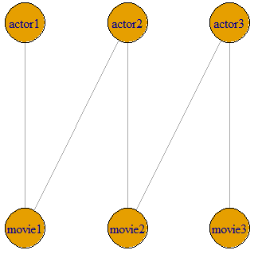
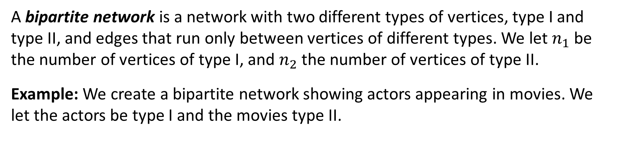
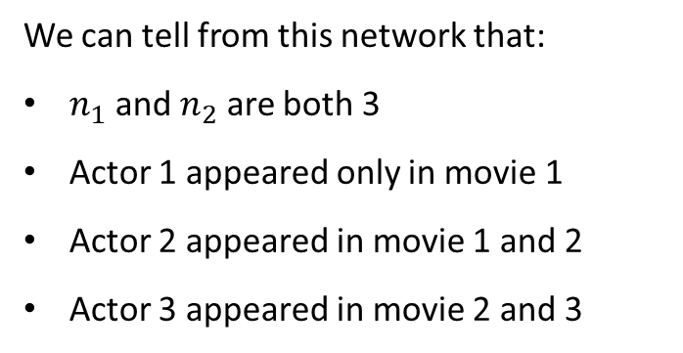
Bipartite Networks
A bipartite network is a network with two different types of vertices, type I and type II, and edges that run only between vertices of different types. We let $n_{1}$ be the number of vertices of type I, and $n_{2}$ the number of vertices of type II.
Example: We create a bipartite network showing actors appearing in movies. We let the actors be type I and the movies type II.
We can tell from this network that:
$n_{1}$ and $n_{2}$ are both 3
Actor 1 appeared only in movie 1
Actor 2 appeared in movie 1 and 2
Actor 3 appeared in movie 2 and 3

Slide 5
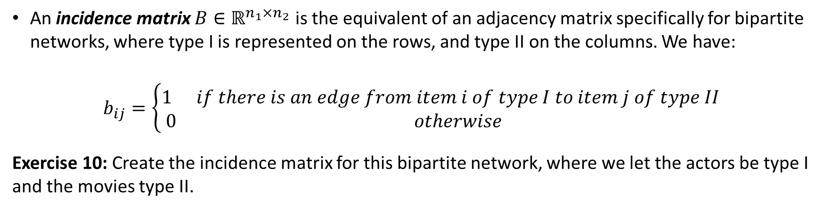
Bipartite Networks - 2
An incidence matrix $B∈ℝ^{n_{1}×n_{2}}$ is the equivalent of an adjacency matrix specifically for bipartite networks, where type I is represented on the rows, and type II on the columns. We have:
$$b_{ij}=\left\{\begin{matrix}1 & if there is an edge from item i of type I to item j of type II \\ 0 & otherwise\end{matrix}\right.$$
Exercise 10: Create the incidence matrix for this bipartite network, where we let the actors be type I and the movies type II.
Incidence Matrix
movie1 movie2 movie3
actor1 1 0 0
actor2 1 1 0
actor3 0 1 1

Slide 6
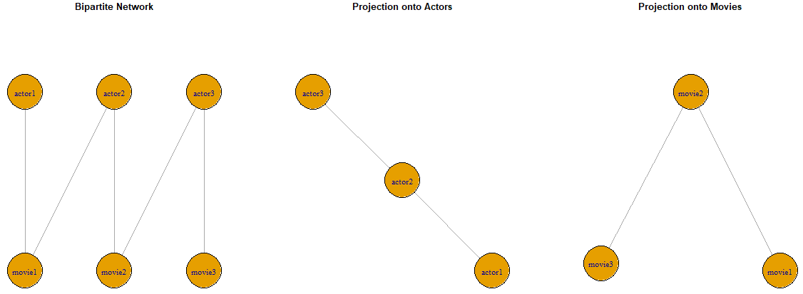
Bipartite Networks - 3
The one-mode projection onto type I of a bipartite network is the network that has only vertices of type I and connects two vertices if they are both connected to the same type II element in the bipartite network.
The one-mode projection onto type II of a bipartite network is the network that has only vertices of type II and connects two vertices if they are both connected to the same type I element in the bipartite network.
NOTE: the projections are NOT subgraphs of the bipartite graph.
Example: The projection onto actors gives a network of actors with an edge between actors that have acted in the same movie, while the projection onto movies gives the network of movies where two movies are connected by an edge if they share one or more actors.

Slide 7
Problems
Figure 6.4 b) in the book (page 114) shows a bipartite network. Let the white vertices be named A, B, C, and D respectively. Create the bipartite network in R and plot it, both as a regular network and as a bipartite network. Which makes the structure of the network clearer? Then calculate its incidence matrix, first without, then WITH R. Is it the same as the incidence matrix B in the book (page 116)?
The middle of figure 6.6 in the book (page 117) also shows a bipartite graph. Create and plot this graph in R, both as a regular network and as a bipartite network, find its incidence matrix and projections onto the letters and onto the numbers. Does it match what the book shows for the projections? Are either of these projections acyclic?

Slide 8
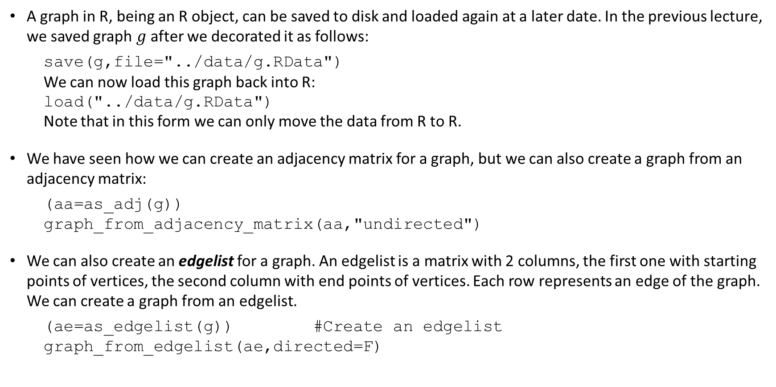
Import and Export Network Data Adjacency Matrices and Edgelists
A graph in R, being an R object, can be saved to disk and loaded again at a later date. In the previous lecture, we saved graph $g$ after we decorated it as follows:
save(g,file="../data/g.RData")
We can now load this graph back into R:
load("../data/g.RData")
Note that in this form we can only move the data from R to R.
We have seen how we can create an adjacency matrix for a graph, but we can also create a graph from an adjacency matrix:
(aa=as_adj(g))
graph_from_adjacency_matrix(aa,"undirected")
We can also create an edgelist for a graph. An edgelist is a matrix with 2 columns, the first one with starting points of vertices, the second column with end points of vertices. Each row represents an edge of the graph. We can create a graph from an edgelist.
(ae=as_edgelist(g)) #Create an edgelist
graph_from_edgelist(ae,directed=F)

Slide 9
Import and Export Network Data Data Frames
Using adjacency matrices and edgelists cause the loss of attribute information. We can, however, create data frames instead that will hold all the information available in the graph.
For a graph without attributes it is easiest to move data across systems using either adjacency matrices or edgelists.
For a graph WITH attributes we should move data across systems using data frames. The igraph function as_data_frame creates a data frame for the edges and their attributes, a data frame for the vertices and their attributes, or a list containing both data frames. For the graph attributes, we may use the base function as.data.frame:
(dfg=as_data_frame(g,"both"))
(dfgg=as.data.frame(graph_attr(g))
We can create a graph from two data frames, the edges data frame and the vertices data frame. Note that the vertices data frame is optional. However, igraph does not provide an option to include a data frame for the graph attributes. In order to solve this I have written a function called graph_attr_from_df that provides that purpose:
(g2=graph_from_data_frame(dfg$edges,F,dfg$vertices))
(g2=graph_attr_from_df(g2,ga))
We can thus recover the graph g in full from the three data frames we have created.

Slide 10
Import and Export Network Data Data Frames - 2
One popular method is to create up to 3 data sets in Excel (one per sheet), then read the excel data into R data frames. Those data frames can then be combined to produce a graph. Note that the package readxl is required for this.
(gtEdges=read_excel("../data/test.xlsx",sheet=1))
(gtVertices=read_excel("../data/test.xlsx",2))
(gtGraph=as.data.frame(read_excel("../data/test.xlsx",3)))
#Create an undirected graph
gt=graph_from_data_frame(gtEdges,directed=F,gtVertices)
(gt=graph_attr_from_df(gt,gtGraph))
Note that the function read_excel creates a tibble rather than a data frame.
We may also obtain the three data frames we need from text files, that we can read into R and convert to a graph:
laze=read.table("../data/lazega_edges.txt")
laza=read.table("../data/lazega_vertices.txt",header=T)
lazg=read.table("../data/lazega_graph.txt",header=T)
lazega=graph_from_data_frame(laze,F,laza)
(lazega=graph_attr_from_df(lazega,lazg))

Slide 11
Import and Export Network Data Other Methods
There are other ways of writing and reading external text files; igraph provides the functions write_graph and read_graph. They are useful only for graphs with no decoration other than edge weights.
#Edge list is the default, but this writes ids minus 1, no names
write_graph(g,"../data/ggraph.txt")
#This way we do get vertex names, and also the weights are stored
write_graph(g,"../data/ggraph.txt","ncol")
#Import a graph from an external file with names and weights
read_graph("../data/ggraph.txt","ncol",directed=F)
Sometimes other people may create data sets and make them available via a package. The package igraphdata has such data sets:
data(package="igraphdata")

Slide 12
Components
If an undirected network is not connected, then it has two or more separate parts that are disconnected from each other. We call those parts components. A component is a maximally connected subgraph, i.e. a subset of vertices of a network such that there exists at least one path from each vertex in that subset to each other vertex in that subset (i.e. the component is connected), and such that we cannot add any other vertex to this subset while preserving this property (i.e. it is maximal).
A vertex that is connected to no others is considered a component of size one.
Every vertex of a network belongs to exactly one component.
A network with more than one component is disconnected.
Many disconnected networks have a giant component; this is always the largest component, and usually contains more than half of the vertices in the network.
g2=g
is_connected(g2) #This graph is connected
components(g2) #Only one component
g2=g2-edge(c("Jill|Jack","Pete|Mary","Jill|Pete","Jill|Joe"))
is_connected(g2) #No longer connected
components(g2) #Now we have three components

Slide 13
Components - 2
We saw earlier that a digraph is weakly connected if the underlying undirected graph is connected, and strongly connected if there is at least one directed path from every vertex to every other vertex. Similarly, we have weakly connected components and strongly connected components. A weakly connected component is a component of the underlying unconnected graph, while a strongly connected component is a maximal subset of vertices such that there is a directed path in both directions between every pair of vertices in the subset.
load("../data/gd.RData") #Load a digraph
is_connected(gd,mode="weak") #Weakly connected
is_connected(gd,mode="strong") #Strongly connected
components(gd,mode="strong") #Just one component
gd2=gd-edge(get.edge.ids(gd,c("6","4","4","1")))
is_connected(gd2,mode="weak") #Weakly connected
is_connected(gd2,mode="strong") #Not strongly connected
distances(gd2,mode="out") #Which vertices are the problem?
(co=components(gd2,mode="strong")) #Three components
Every strongly connected component with more than one vertex must contain at least one cycle.
A DAG has only components of size one; one component for each vertex.

Slide 14
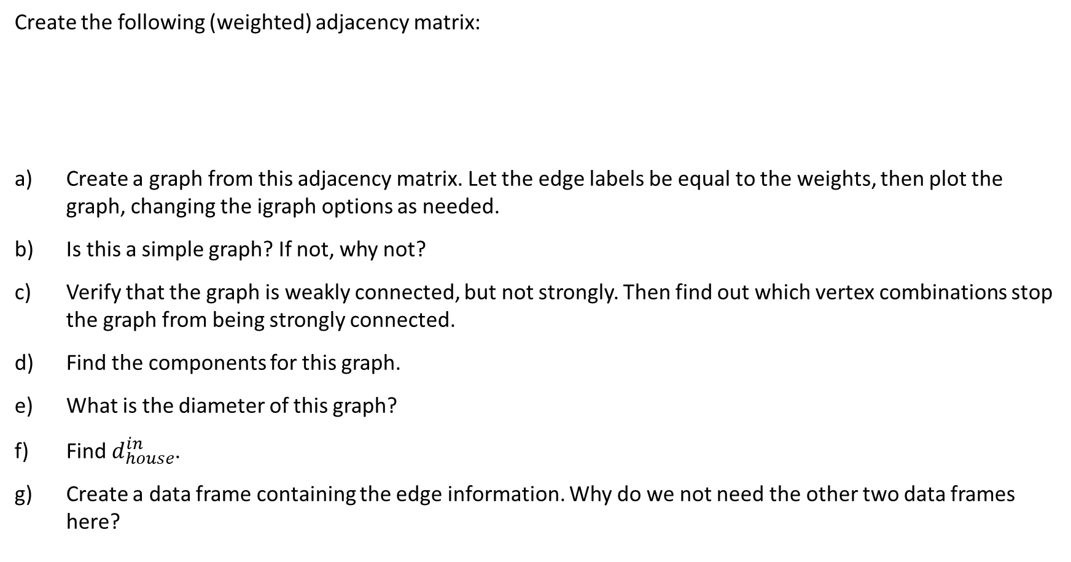
Problem
Create the following (weighted) adjacency matrix:
Create a graph from this adjacency matrix. Let the edge labels be equal to the weights, then plot the graph, changing the igraph options as needed.
Is this a simple graph? If not, why not?
Verify that the graph is weakly connected, but not strongly. Then find out which vertex combinations stop the graph from being strongly connected.
Find the components for this graph.
What is the diameter of this graph?
Find $d_{house}^{in}$.
Create a data frame containing the edge information. Why do we not need the other two data frames here?
house yard town car
[1,] 2 0 0 0
[2,] 5 0 5 3
[3,] 3 2 3 0
[4,] 8 1 2 0

Slide 15
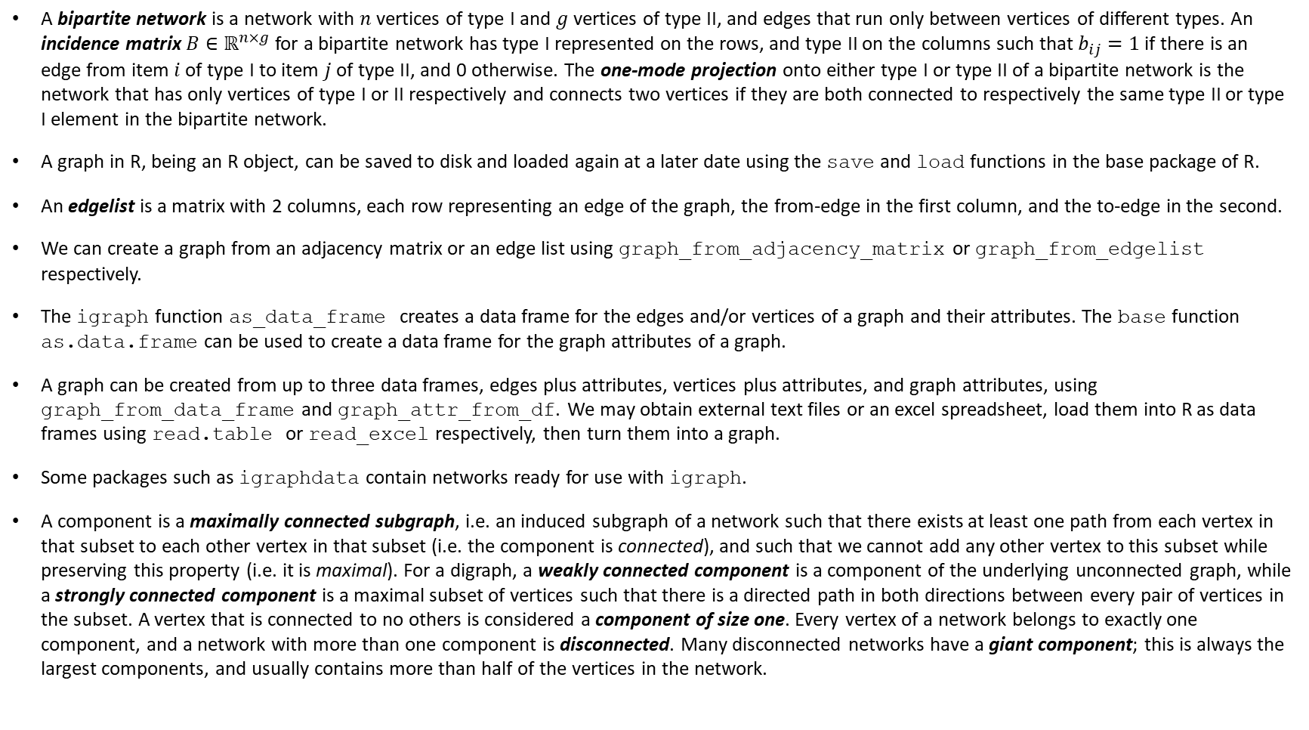
Today’s Summary
A bipartite network is a network with $n$ vertices of type I and $g$ vertices of type II, and edges that run only between vertices of different types. An incidence matrix $B∈ℝ^{n×g}$ for a bipartite network has type I represented on the rows, and type II on the columns such that $b_{ij}=1$ if there is an edge from item $i$ of type I to item $j$ of type II, and 0 otherwise. The one-mode projection onto either type I or type II of a bipartite network is the network that has only vertices of type I or II respectively and connects two vertices if they are both connected to respectively the same type II or type I element in the bipartite network.
A graph in R, being an R object, can be saved to disk and loaded again at a later date using the save and load functions in the base package of R.
An edgelist is a matrix with 2 columns, each row representing an edge of the graph, the from-edge in the first column, and the to-edge in the second.
We can create a graph from an adjacency matrix or an edge list using graph_from_adjacency_matrix or graph_from_edgelist respectively.
The igraph function as_data_frame creates a data frame for the edges and/or vertices of a graph and their attributes. The base function as.data.frame can be used to create a data frame for the graph attributes of a graph.
A graph can be created from up to three data frames, edges plus attributes, vertices plus attributes, and graph attributes, using graph_from_data_frame and graph_attr_from_df. We may obtain external text files or an excel spreadsheet, load them into R as data frames using read.table or read_excel respectively, then turn them into a graph.
Some packages such as igraphdata contain networks ready for use with igraph.
A component is a maximally connected subgraph, i.e. an induced subgraph of a network such that there exists at least one path from each vertex in that subset to each other vertex in that subset (i.e. the component is connected), and such that we cannot add any other vertex to this subset while preserving this property (i.e. it is maximal). For a digraph, a weakly connected component is a component of the underlying unconnected graph, while a strongly connected component is a maximal subset of vertices such that there is a directed path in both directions between every pair of vertices in the subset. A vertex that is connected to no others is considered a component of size one. Every vertex of a network belongs to exactly one component, and a network with more than one component is disconnected. Many disconnected networks have a giant component; this is always the largest components, and usually contains more than half of the vertices in the network.

